Slide 1

Requirement Analysis
CodePros

Slide 2

Overview
Methods Employed in requirement gathering.
Time management
Requirement specifications.
Use Case Diagram.
Activity Diagram.

Slide 3

Methods used in requirement Analysis
Initial Brainstorming on user requirement.
Back and Forth Meetings with customer.
Categorizing requirement into functional and non-functional user requirement.
Harmonisation of user requirements.

Slide 4

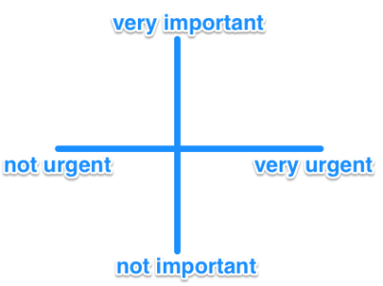
Time Management
Due to Steeper Learning Curve, Each Team member is putting in 12 to 16 hrs
on weekly basis. Approximately 60hrs - 80hrs amongst the five team
members.
We employ Pareto principle in categorizing task .

Slide 5

Requirement Specification
Track income and expenses:
As a user, I can monitor my monthly income and expenses.
Home page:
As a user, I can see my previous entries for expenses and income.
As a user, I can see the total sum of my expenses as well as income.
As a user, I can make (quick) entries with a (shortcut) button.

Slide 6
Requirement Specification contd.
Data collection:
As a user, I can enter the amount as an expense or as an income in the entry form.
As a user, I can select the date when making a new transaction.
Categories:
As a user, I can sub-categorize my expenses or income transactions.
Default categories: Bills, Groceries, Household items.

Slide 7
Requirement Specification contd.
Currency:
As a user, I can select the currency for my transactions from the settings menu.
Security:
As a user, I can set password or skip.

Slide 8
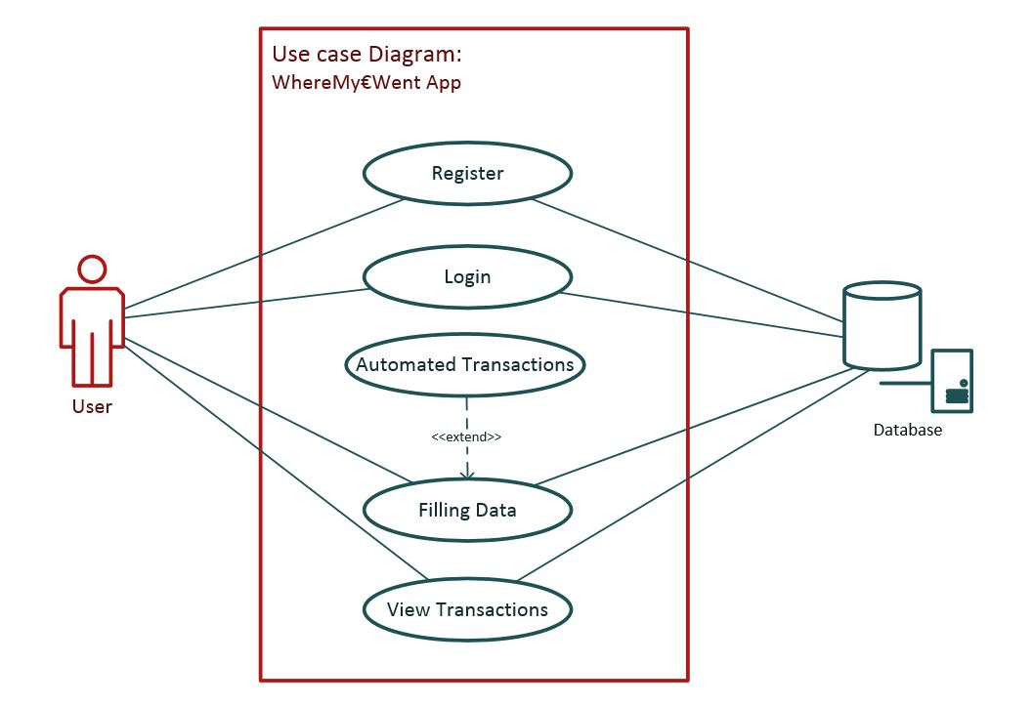
Activity Diagram

Slide 9
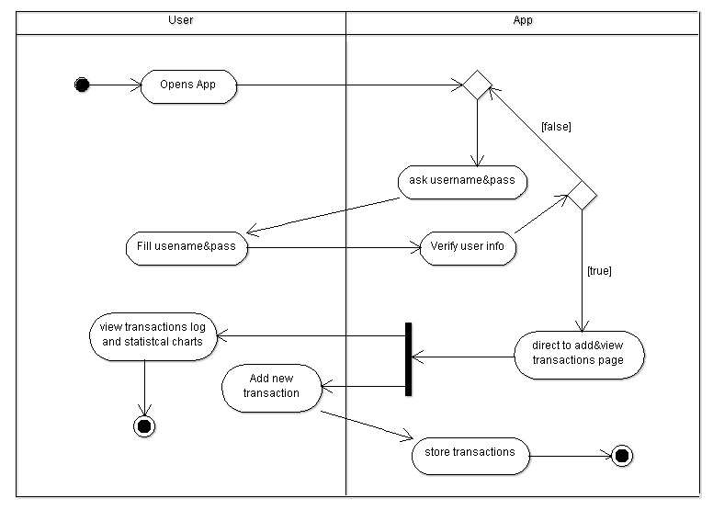
Activity Diagram

Slide 10

Thank You and Questions.
-Team CodePros

